Slide 1
How to get your dreaM JOB Resume & job hunting tips
Andy Mallon he/him

Slide 2

Slides & content available on GitHub
PowerPoint Slides
My annotated resume
am2.co/dream-job-ppt

Slide 3

Andy Mallon
I sell furniture at the mall
Database Architect at Wayfair.com*
Working with SQL Server since 2003
Background in Tech Support, Database Administration, and Database Architecture
Lazy
Impatient
* The views & opinions expressed in this presentation are mine alone and do not reflect the views of my employer.

Slide 4

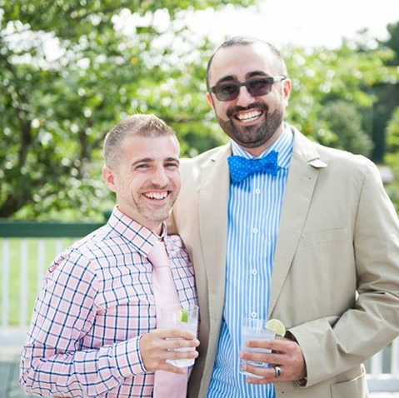
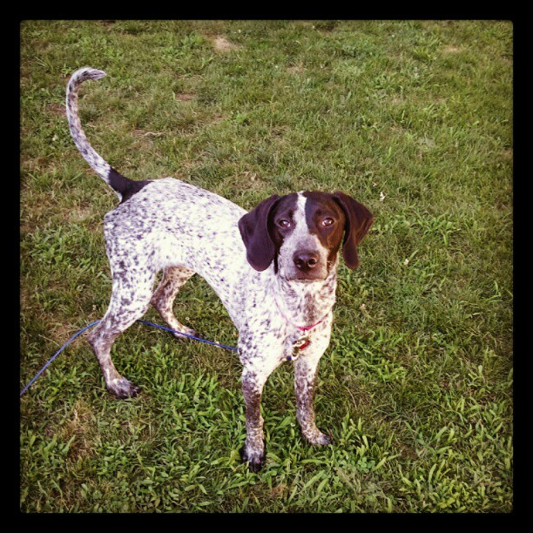
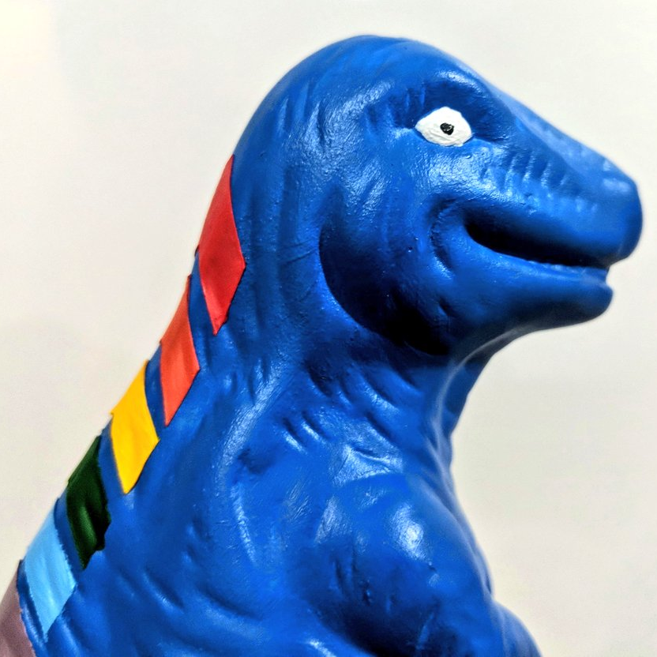
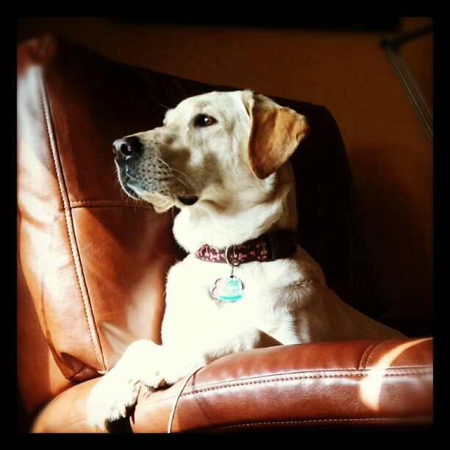

Notes:
Some of the things I love most in life– My husband, my pups, Queery the Diversity Dino.

Slide 5



Contact Andy
Andy@AMtwo.co
@AMtwo
am2.co/shortcuts
andy@am2.co

Slide 6

Session Feedback
Tell me what you don’t like
Tell me what can be better
Tell me what you like

Slide 7


Yea…….You apparently didn’t put one of the new coversheets on your TPS reports.
I'm also gonna need you to go ahead and silence your phones and devices

Slide 8
Agenda
My story – Why I’m living my dream
Setting your career goals
WTF is a resume?
How to write a resume
How to navigate a job interviews & offers

Slide 9

Warning: I’m American
This topic is cultural
My advice comes from my experience & perspective
Tech industry
United States

Slide 10
My story: Why I’m living my dream

Slide 11






My story isn’t particularly unique
First tech job
Blogging + speaking
University
First job
First DBA job
Today

Slide 12
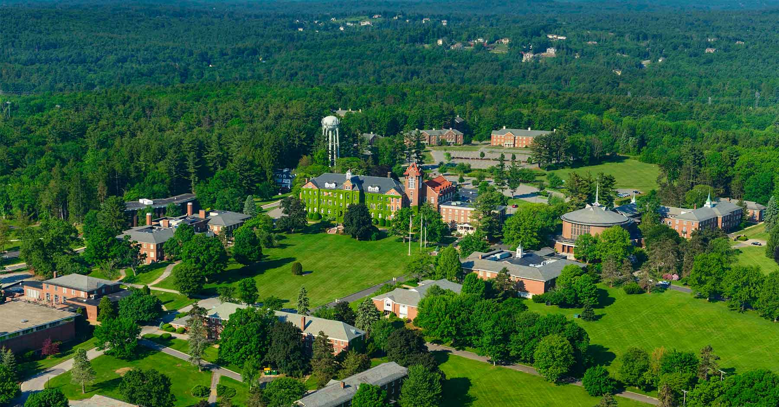

Education

Slide 13


My first job

Slide 14

My first tech job

Slide 15

My first DBA job

Slide 16
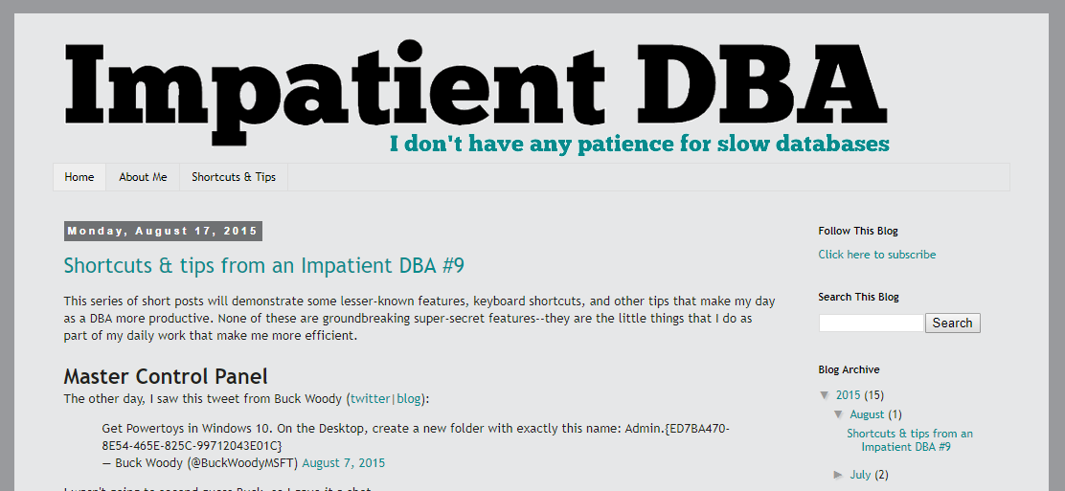
Blogging + speaking
Notes:
In May 2014, I started blogging. I wrote 3 blog posts in 2014.
In the first 12 months, I wrote 6 blog posts.
In the following 12 months, I wrote 33 blog posts, and started speaking at user groups & SQLSaturday

Slide 17

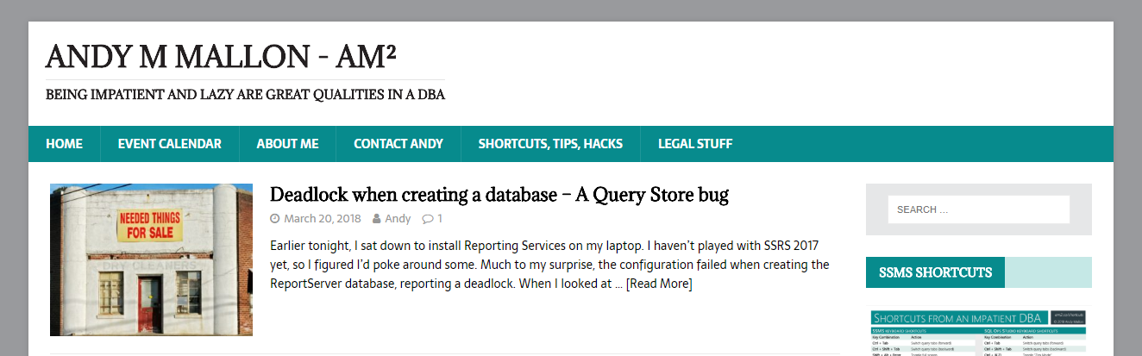



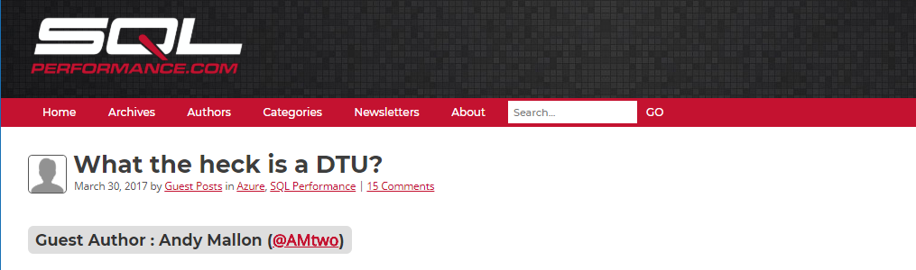

Today

Slide 18
Setting your career goals

Slide 19
What do you want to do?
“You can do anything if you put your mind to it”
This is totally a lie
I will never be an opera singer

Slide 20
Where do you want to be?
You can’t get there if you don’t know where you’re going
Do you want to be a spirulina rancher?
Do you want to work for Microsoft?

Slide 21
How can you get there?
It doesn’t have to be a direct route
Everyone has missteps & detours
My path to here hasn’t always been direct…

Slide 22
Who can help you get there?
Networking is important
Referrals / references are important
Sponsorship / mentorship can be tremendously helpful

Slide 23
WTF is a resume?

Slide 24


What is the purpose of your resume?
It’s to get a new job, right?
Nope
Your resume gets you an interview
Your interview gets you a job

Slide 25
How to write a bad resume

Slide 26

Bad resumes are…
Sloppy
Long
Repetitive
Inconsistent
Ugly
Careless
Unprofessional

Slide 27
Avoid these common pitfalls
Irrelevant jobs don’t belong on your resume
Is “perfume counter at Macy’s” relevant?
Don’t repeat the same thing for every job
“Responsible for backup & recovery” is implied in DBA
Put it on the most relevant job

Slide 28
Professional Email Address
Use your name
Don’t give away your age (more on this later)
Don’t use an unprofessional domain
Don’t use BostonHottieGuy666@butz.com

Slide 29
How to write a good resume

Slide 30

Good resumes…
The opposite of bad
Tidy
Concise
Accurate
Pretty
Thoughtful
Professional
Tell a story

Slide 31
Be professional, but BE YOURSELF
Professional formatting
Professional language
Professional tone
Don’t over-sell yourself
Don’t under-sell yourself
Don’t hide your personality

Slide 32
Nobody wants to read your resume
Start with the most important bits
Grab the reader’s attention early
Understand the inverted pyramid
Don’t bury the lede

Slide 33
Most résumé-worthy
Important details
Other info
Who
What
When
Where
Why
Notable projects
Major accomplishments
Current job information
Complete relevant work history
Additional details on notable projects
Education history

Slide 34
Inverted Pyramid
If someone stops reading ½ of a page in…
Did they get a good initial picture of you?
Did you want to tell them something else?
You should feel good about their decision

Slide 35
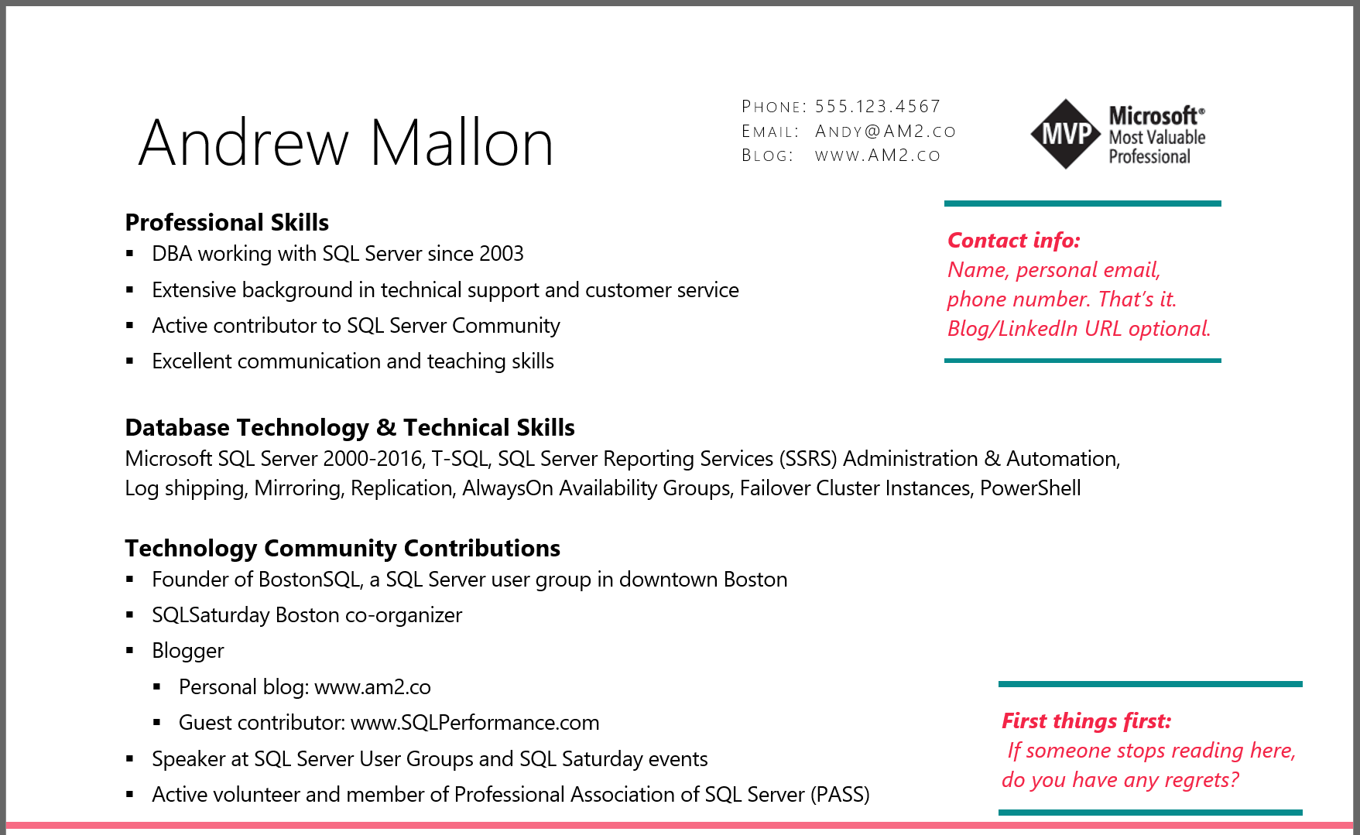

Slide 36



Spice up your experience with detail
Boring
Exciting
Responsible for backups and restores of SQL Server databases.
Standardized backup process across all 100 servers in environment; Implemented automated process to regularly test restores of every database.

Slide 37


Spice up your experience with detail
Boring
Exciting
Performance tuned queries
Reduced CPU utilization by 20% over 6 months, by focusing on performance in code review, as well as proactive performance monitoring & tuning

Slide 38
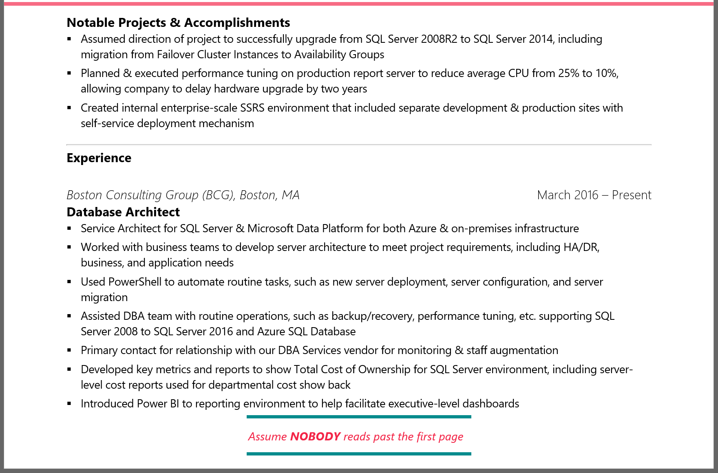
Notes:
I’m no longer with the Boston Consulting Group—This is a slightly dated resume…

Slide 39
Hide important facts about yourself
Are you a woman?
Are you a minority?
Are you young? Old?
Are you a “protected class”?
Why might someone have implicit bias against you?

Slide 40
What is “implicit bias”?
Implicit stereotypes are based on learned associations between various qualities and social categories, including race or gender.
Individuals' perceptions and behaviors can be affected by implicit stereotypes, even without the individuals' intention or awareness.
Notes:
The keyword here is *LEARNED* … Society teaches us these things, not always experience.

Slide 41
What is “implicit bias”?
Implicit stereotypes are based on learned associations between various qualities and social categories, including race or gender.
Society teaches us to associate stereotypes & bias based on these qualities, despite experience to the contrary
Notes:
The keyword here is *LEARNED* … Society teaches us these things, not always experience.

Slide 42
What is “implicit bias”?
Individuals' perceptions and behaviors can be affected by implicit stereotypes, even without the individuals' intention or awareness.
We don’t do it on purpose, and might not even realize we are doing it.
Notes:
The keyword here is *LEARNED* … Society teaches us these things, not always experience.

Slide 43
What is “implicit bias”
If you’re not a straight white dude…
Someone might hold that against you…
And not even realize it

Slide 44
Examples of “Implicit bias triggers”
Stereotypical names around gender or ethnicity
J. Jones instead of Jamal Jones
K.D. Lang instead of Kathryn Dawn Lang
Historically black/female colleges
Year of graduation
“Smith College, 1982”

Slide 45
How to navigate a job interview

Slide 46

Be prepared
Research the company
Check LinkedIn for connections
Research the position

Slide 47

Be prepared
What do you want to learn from them?
What do you want them to learn from you?

Slide 48
Be yourself
You are better at being you than you are at being someone else
They are hiring you
If you land the job, they’ll meet “the real you” eventually

Slide 49
Dress appropriately
You don’t always have to wear a suit!
What’s the best-dressed day you would have at this job?
Dress for that day

Slide 50

Tell your story

Slide 51
How to navigate a job offer

Slide 52
Is the job right for you?
Will you be happy?
People
Work
Commute
Money
Work-life balance

Slide 53
Is the employer right for you?
Industry
Management
Team dynamics
Socio-political leanings

Slide 54
Questions?
am2.co/2016/07/job-hunting-database-professionals/

Slide 55
Resources
Andy’s professional development musings
https://am2.co/category/professional-development/
Steph Locke’s one-page CV template
https://www.overleaf.com/articles/steph-lockes-one-page-cv/wbttfmfqcdtq
Write a killer technical resume in five steps
https://www.brentozar.com/archive/2012/09/write-killer-technical-resume-five-steps/
Jes Borland “Busy is a 4-letter word”
https://youtu.be/3u2yF0ZQlq8?t=184
Rie Irish “Let Her Finish” webinar
https://youtu.be/ib04UR2KRMc?t=6m05s

